Slide 1
L. 15 . A quantitative trait locus (QTL) analysis
A quantitative trait locus (QTL) analysis. Definions
Polygenic inheritance
Multifactorial inheritance
QTL mapping. Models and methods

Slide 2
A quantitative trait locus (QTL)
is a section of DNA (the locus) which correlates with variation in a phenotype (the quantitative trait).
QTLs are mapped by identifying which molecular markers (such as SNPs or AFLPs) correlate with an observed trait.
This is an early step in identifying and sequencing the actual genes that cause the trait variation.

Slide 3
A quantitative trait locus (QTL)
is a region of DNA which is associated with a particular phenotypic trait, which varies in degree and which can be attributed to polygenic effects.
Polygenic effects is the product of two or more genes, and their environment.
These QTLs are often found on different chromosomes.
The number of QTLs which explain variation in the phenotypic trait indicates the genetic architecture of a trait.
It may indicate that plant height is controlled by many genes of small effect, or by a few genes of large effect.

Slide 4
A quantitative trait locus (QTL)
Typically, QTLs underlie continuous traits (those traits which vary continuously, e.g. height) as opposed to discrete traits (traits that have two or several character values, e.g. red hair in humans, a recessive trait, or smooth vs. wrinkled peas used by Mendel in his experiments).
Moreover, a single phenotypic trait is usually determined by many genes.
Consequently, many QTLs are associated with a single trait.
Another use of QTLs is to identify candidate genes underlying a trait.
Once a region of DNA is identified as contributing to a phenotype, it can be sequenced.
The DNA sequence of any genes in this region can then be compared to a database of DNA for genes whose function is already known.

Slide 5
Quantitative traits
Polygenic inheritance is to inheritance of a phenotypic characteristic (trait) that is attributable to two or more genes and can be measured quantitatively.
Multifactorial inheritance is to polygenic inheritance that also includes interactions with the environment.
Unlike monogenic traits, polygenic traits do not follow patterns of Mendelian inheritance (discrete categories).

Slide 6
QTL mapping
For organisms whose genomes are known, one might now try to exclude genes in the identified region whose function is known with some certainty not to be connected with the trait in question.
If the genome is not available, it may be an option to sequence the identified region and determine the putative functions of genes by their similarity to genes with known function, usually in other genomes.
This can be done using BLAST, an online tool.
BLAST allows to enter a primary sequence and search for similar sequences within the BLAST database of genes from various organisms.
It is often not the actual gene underlying the phenotypic trait, but rather a region of DNA that is closely linked with the gene.

Slide 7
BLAST for Basic Local Alignment Search Tool is an algorithm for comparing primary biological sequence information,
such as the amino-acid sequences of proteins or
the nucleotides of DNA sequences

Slide 8
QTL mapping
In a recent development, classical QTL analyses were combined with gene expression profiling i.e. by DNA microarrays.
Such expression QTLs (eQTLs) describe cis- and trans-controlling elements for the expression of often disease-associated genes.
Observed epistatic effects have been found beneficial to identify the gene responsible by a cross-validation of genes within the interacting loci with metabolic pathway- and scientific literature databases.
Epistasis is the phenomenon where the effect of one gene (locus) is dependent on the presence of one or more 'modifier genes', i.e. the genetic background.
Originally the term meant that the phenotypic effect of one gene is masked by a different gene (locus).

Slide 9
Analysis of variance
The simplest method for QTL mapping is analysis of variance (ANOVA, sometimes called "marker regression") at the marker loci.
In this method, in a backcross, one may calculate a t-statistic to compare the averages of the two marker genotype groups.
For other types of crosses (such as the intercross), where there are more than two possible genotypes, one uses a more general form of ANOVA, which provides a so-called F-statistic.

Slide 10
Analysis of variance
The ANOVA approach for QTL mapping has three important weaknesses.
1) we do not receive separate estimates of QTL location and QTL effect. QTL location is indicated only by looking at which markers give the greatest differences between genotype group averages, and the apparent QTL effect at a marker will be smaller than the true QTL effect as a result of recombination between the marker and the QTL. 2), we must discard individuals whose genotypes are missing at the marker.
3) , when the markers are widely spaced, the QTL may be quite far from all markers, and so the power for QTL detection will decrease.

Slide 11
Interval mapping
Lander and Botstein developed interval mapping, which overcomes the three disadvantages of analysis of variance at marker loci. Interval mapping is currently the most popular approach for QTL mapping in experimental crosses.
The method makes use of a genetic map of the typed markers, and, like analysis of variance, assumes the presence of a single QTL.
In interval mapping, each locus is considered one at a time and the logarithm of the odds ratio (LOD score) is calculated for the model that the given locus is a true QTL.
The odds ratio is related to the Pearson correlation coefficient between the phenotype and the marker genotype for each individual in the experimental cross.

Slide 12
Interval mapping
The term ‘interval mapping’ is used for estimating the position of a QTL within two markers (often indicated as ‘marker-bracket’). Interval mapping is originally based on the maximum likelihood but there are also very good approximations possible with simple regression.
The principle for QTL mapping is:
1) The Likelihood (Вероятность) can be calculated for a given set of parameters (particularly QTL effect and QTL position) given the observed data on phenotypes and marker genotypes.
2) The estimates for the parameters are those where the likelihood are highest.
3) A significance threshold (порог) can be established by permutation (перестановка) testing.

Slide 13
Interval mapping
Conventional methods for the detection of quantitative trait loci (QTLs) are based on a comparison of single QTL models with a model assuming no QTL. For instance in the “interval mapping” method the likelihood for a single putative QTL is assessed at each location on the genome. However, QTLs located elsewhere on the genome can have an interfering effect.

Slide 14
Interval mapping
As a consequence, the power of detection may be compromised, and the estimates of locations and effects of QTLs may be biased (LANDER and BOTSTEIN 1989; KNAPP 1991). Even nonexisting so-called “ghost” QTLs may appear (HALEY and KNOTT 1992; MARTINEZ and CURNOW 1992). Therefore, it is obvious that multiple QTLs could be mapped more efficiently and more accurately by using multiple QTL models. One popular approach to handle QTL mapping where multiple QTL contribute to a trait is to iteratively scan the genome and add known QTL to the regression model as QTLs are identified. This method, termed composite interval mapping determine both the location and effects size of QTL more accurately than single-QTL approaches, especially in small mapping populations where the effect of correlation between genotypes in the mapping population may be problematic

Slide 15
Introduction
QTL analyses are specialized techniques that construct genetic linkage maps to locate loci (QTLs) that affect a quantitative trait and estimate the genetic effect of QTLs on the trait.
These techniques range from the relatively simple Single Marker Analysis, to the more complex Composite Interval Mapping, where multiple linked markers are taken into consideration.

Slide 16
JMP Genomics has three different methodologies for quantitative trait loci (QTL) analysis:
Single Marker Analysis
Interval Mapping (IM)
Composite Interval Mapping (CIM).

Slide 17
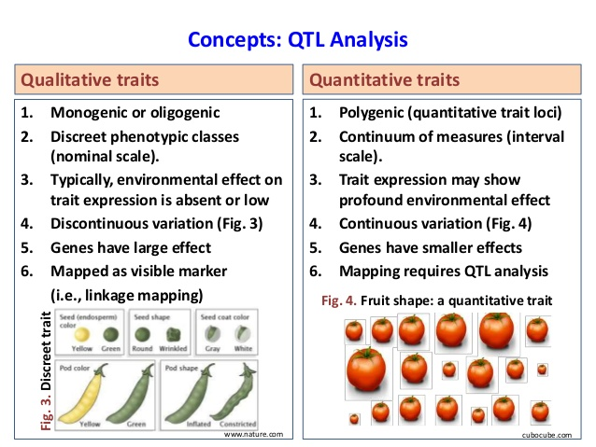

Slide 18
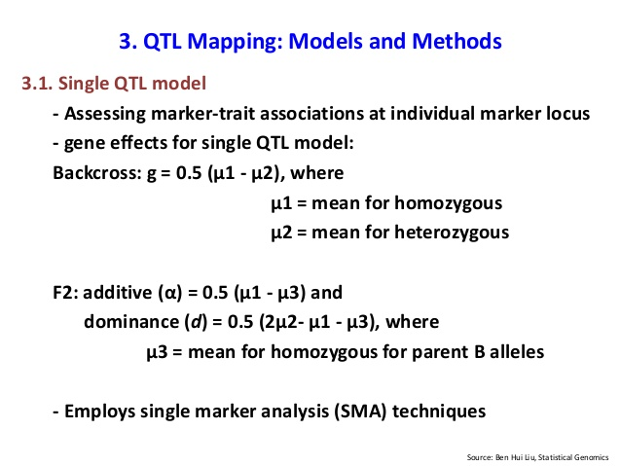

Slide 19
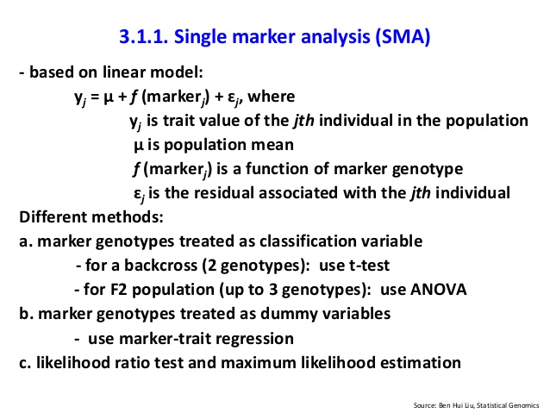

Slide 20
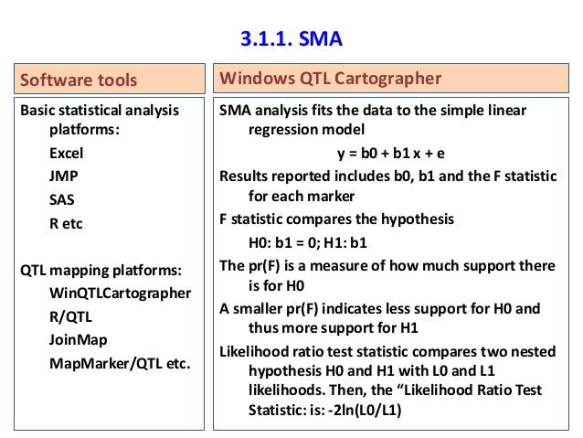

Slide 21
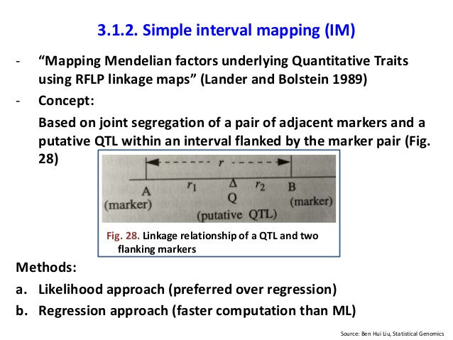

Slide 22
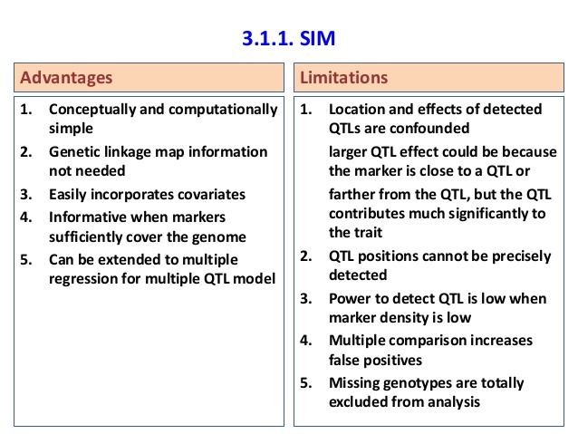

Slide 23
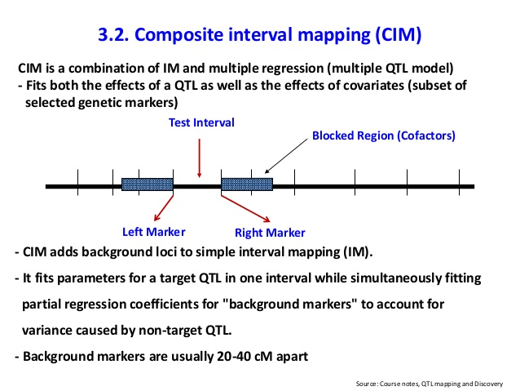

Slide 24
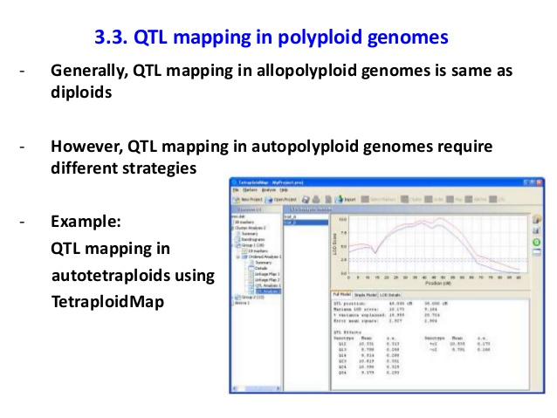

Slide 25
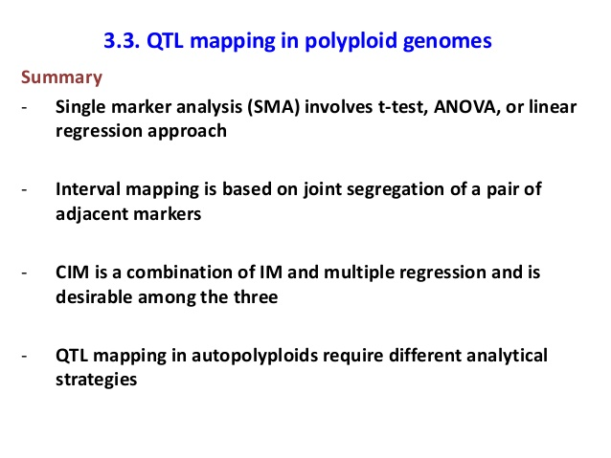

Slide 26
The end

